Slide 1

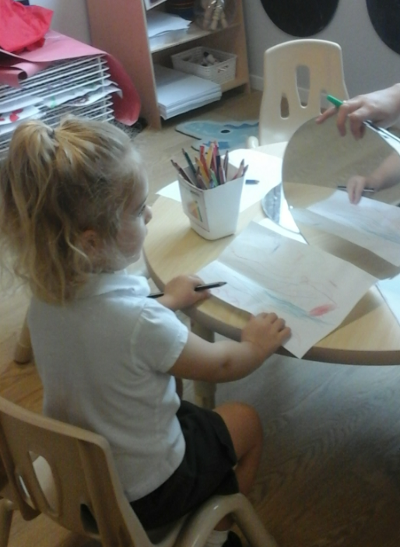
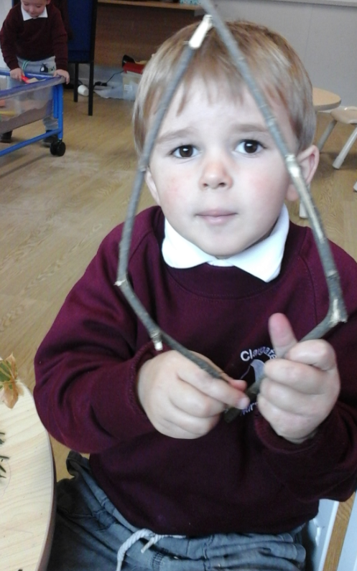
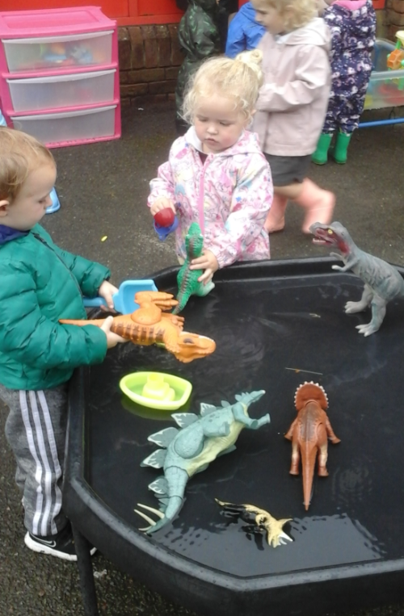

Welcome to Acorns Nursery Curriculum Evening

Slide 2
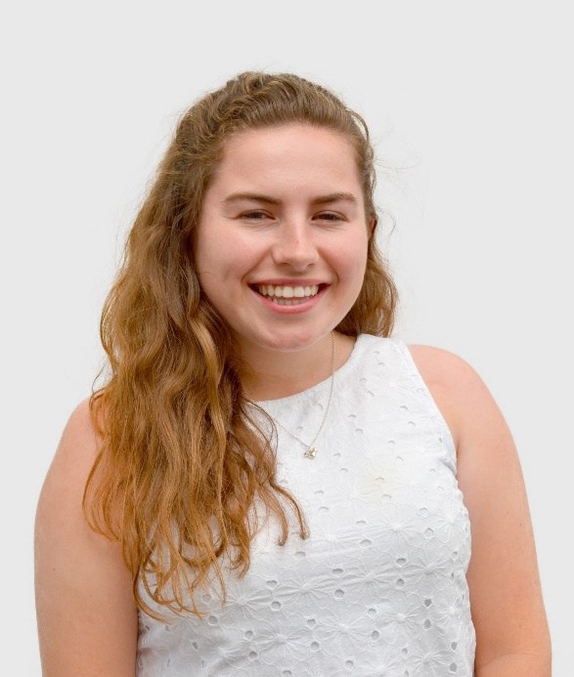

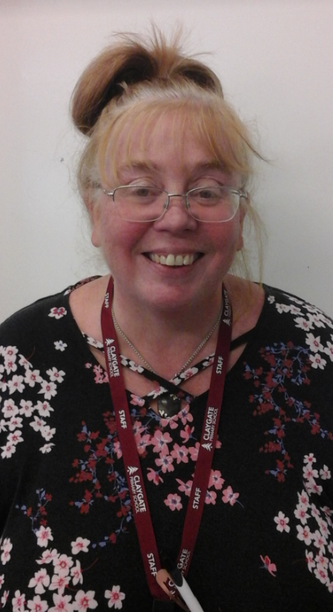
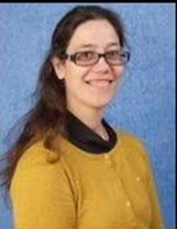
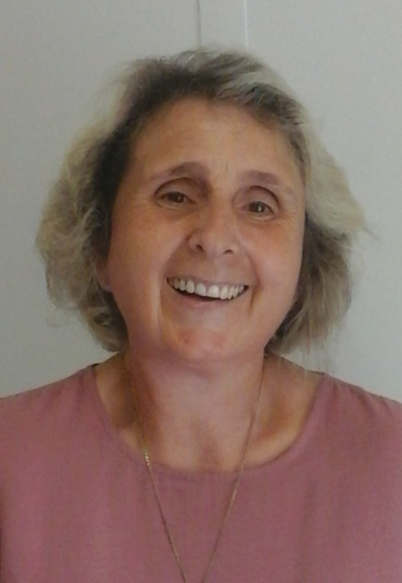
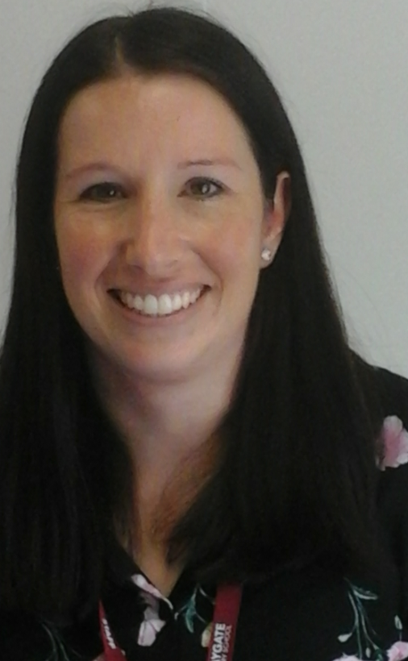
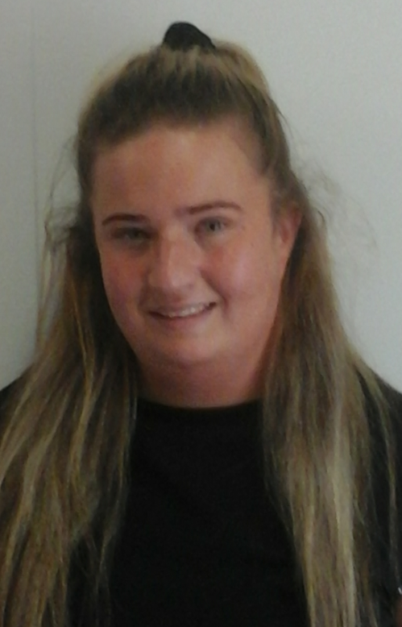
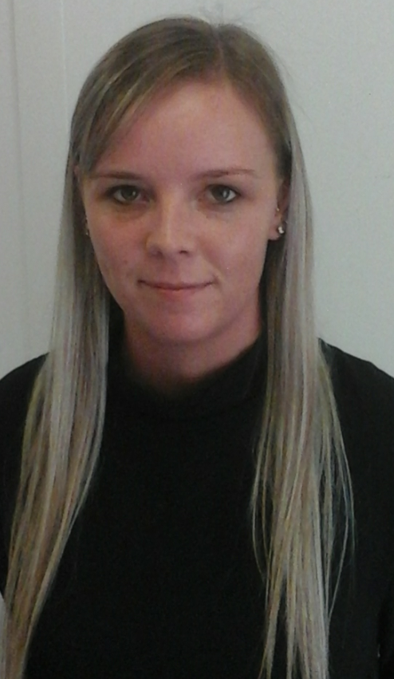
Meet the Team
Miss Dias – Head of EYFS Mrs Fransella – Nursery Lead
Mrs Evans Miss Osborne Mrs Stack Miss Potter

Slide 3
Meet the Senior Leadership Team
Sandra Cunningham: Head Teacher
Marita Cunniffe: Inclusion Lead
Hilary Ali: Deputy Head and DSL
Holly Moorhouse: Head of KS2 & Leader of Curriculum
Susan Minter: Head of KS1
Luisa Dias: Head of EYFS

Slide 4

Our CPS Values

Slide 5
Our Expectations
Independent learners – making choices and showing their interests
Take ‘risks’ and solve problems
Attendance and Punctuality
Be confident individuals
Smart and ready for learning
Birthday books for class library are welcome. Reminder that we don’t give out sweets for allergies and religious reasons.
Have a ‘can do’ attitude when facing difficulties
Express pride in their own achievements

Slide 6
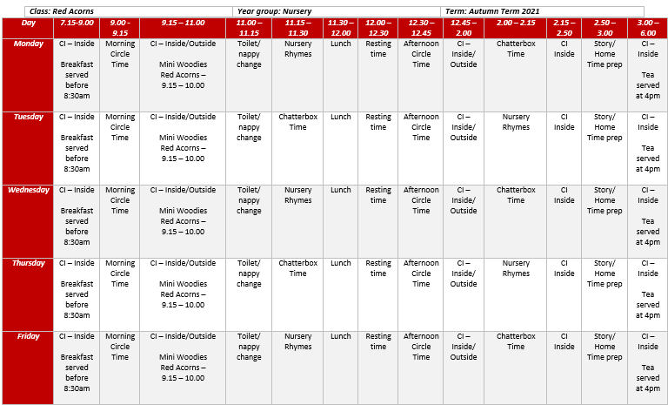
Timetable – Red Acorns

Slide 7
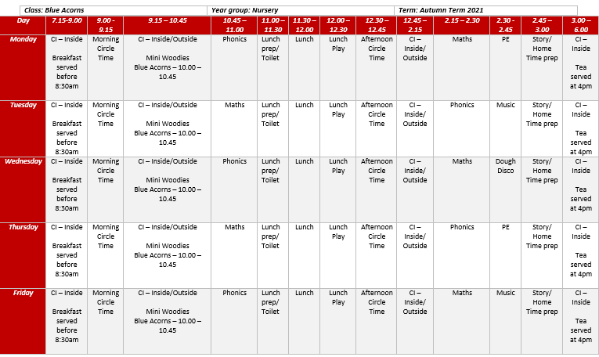
Timetable – Blue Acorns

Slide 8
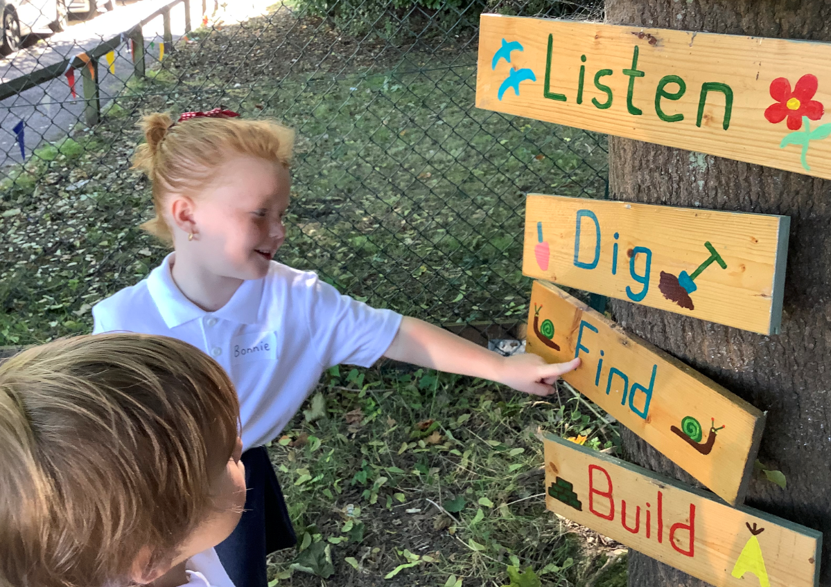
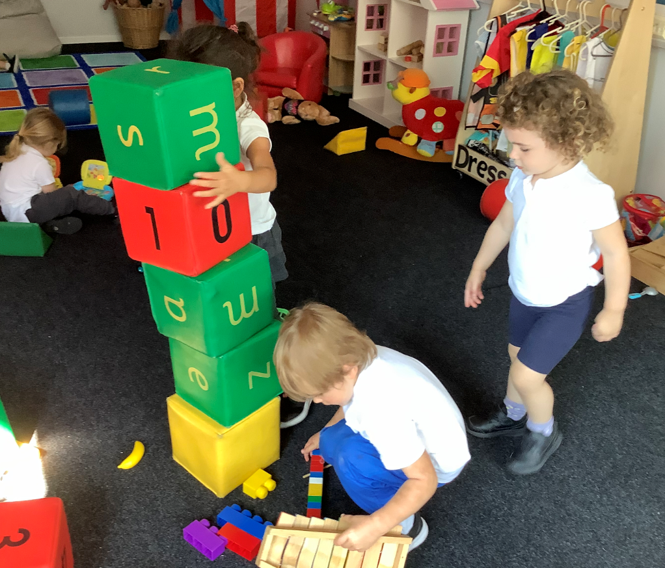
Learning Through Play
Teacher Input – Blue Acorns
English/Topic
Phonics
Circle time
Maths
Teacher Input – Red Acorns
Nursery rhymes/stories
Chatterbox
Child Initiated
Inside/outside
Mini-Woodies – 45min per day

Slide 9
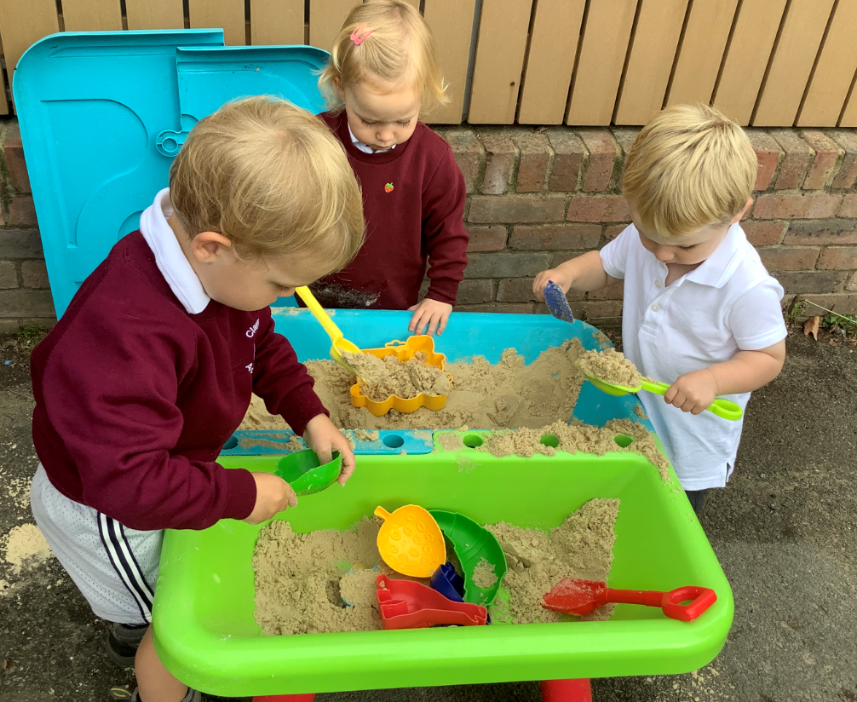
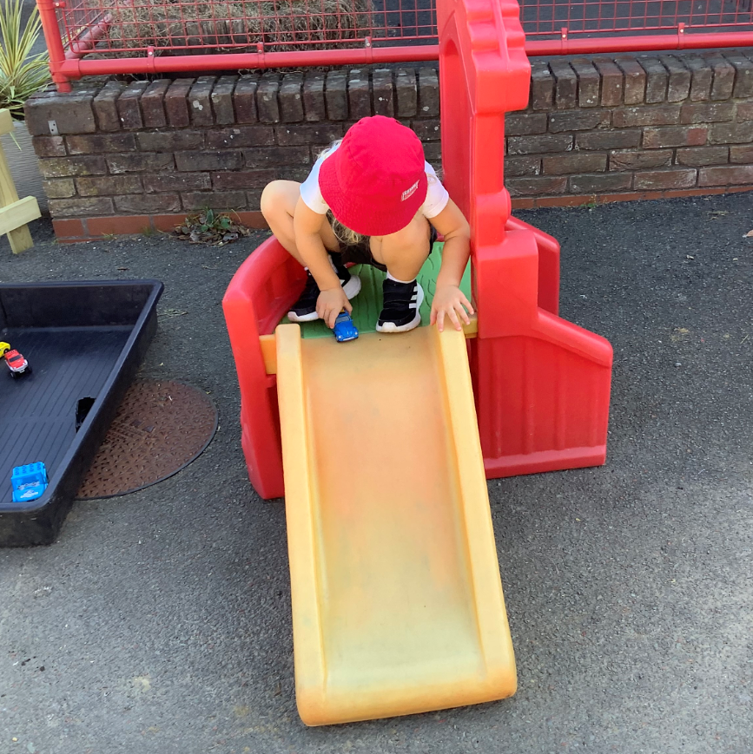
EYFS Curriculum
Prime Areas:
Personal, Social and Emotional Development
Communication and Language
Physical Development
Specific Areas (Blue Acorns)
Literacy
Maths
Understanding the World
Expressive Arts and Design

Slide 10
Phonics
Phonics is taught everyday during discrete phonics lessons
We now follow Little Wandle Letters and Sounds Revised
Nursery children – Foundations for Phonics
Sharing stories and poems
Rhymes and action rhymes
Listening and attention, including oral blending
Develop vocabulary and high quality language

Slide 11
EYFS Assessment
OPAL – Observation of Play and Learning
All children baseline – parents receive report on 1st October
Children assessed on their birth month and 6 months later
Milestones based on child’s age
Met/not yet
Parents view added on reports
Red Acorns – 2 year old progress check

Slide 12
EYFS Parents Evening for Nursery
28th and 29th September
Talk about settling in and next steps
On the child’s assessment month parents will be asked to meet the class teacher to add their views on the report and to discuss next steps

Slide 13
Observations
All staff completes group observations of the children’s learning and play every day. These observations will be uploaded to Google Classroom – only children tagged.
Parents to log in to Google Classroom regularly to check observations and communications.
Emoji passwords for Google Classroom are stuck on your child’s reading diary.
Individual WOW observations are written as needed and stuck on your child’s paper learning journey that will be shared with you at the end of the year and pop-ins

Slide 14
Daily Feedback
Red Acorns – staff will be able to give feedback on your child’s day. this includes nappies, sleep and lunch. Information is given verbally and on request.
Blue Acorns – we encourage children to verbalise their favourite daily activity to their parents at the end of the day. Staff will feedback on more detailed information where necessary.

Slide 15
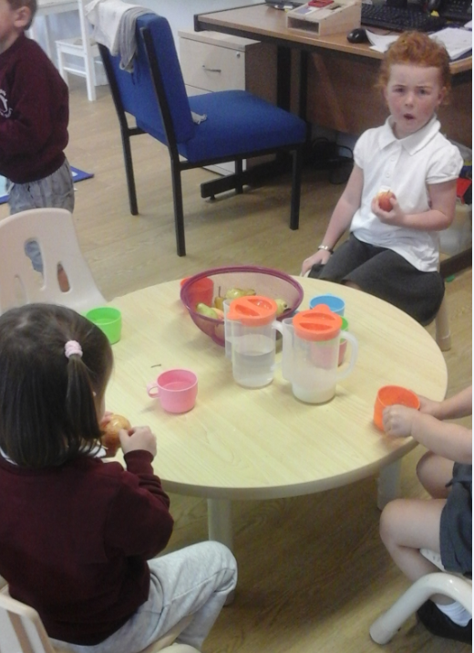
Snack
In Nursery there is a rolling snack café open at all times.
Children can help themselves to fruit, milk and water.
This is optional but we will remind children that they can visit the snack café.
Children sign in with their photo and they need to wait until a seat is available.
Please do not bring a snack from home.

Slide 16
What to bring to nursery
Book bag, no rucksacks
Reading folder with reading diary
Water bottle with only water in
Healthy packed lunch inside a labelled lunch box
Jacket or hat depending on weather
Waterproofs and wellies to stay in school
A whole set of spare clothes, including knickers, top, socks and bottoms/ dress- all items must be labelled and stay at nursery

Slide 17
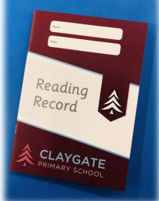
Reading journals/records
Story book – children will independently choose a book of interest every week depending on their days of attendance
School adults record in green pen
Reading daily and recording on reading records – Parents to read a story book to their child and to write a comment on their child’s reading record
Reading records will be checked when children change their story book

Slide 18
Communication
Weekly school and nursery newsletter, Twitter, Instagram and Website
office@claygate.surrey.sch.uk should be used for the majority of enquiries and communication needs (Tel 01372 465 348)
Class teachers may however also be contacted via email and will endeavour to respond within 24 hours – emails won’t be replied to during school hours
If you have any issues, please first see a member of the teaching team
Miss Dias is the head of EYFS
If you have any concerns, our inclusion leader, Mrs Cunniffe can be contacted on sen@claygate.surrey.sch.uk

Slide 19
Volunteers, PA and Friends
We would love to have volunteers to support us across the school. Currently this is something which remains on pause
All parents and carers are automatically members of Claygate Primary School Parents Association: Class reps
Friends Of Claygate Primary School: Voluntary donations (and even better with gift aid) actually helps us to keep CPS fully equipped and running.

